Slide 1

Diary of a Wimpy Kid
Old school
Teodor Petrović 4/4

Slide 2



Diary of a Wimpy Kid Old School
Diary of a Wimpy Kid: Old School by Jeff Kinney tells the story of Greg Heffley as his town decides to disconnect from modern technology and return to “simpler times.”
Through humorous and sometimes chaotic events — especially at Hard Scrabble Farms — the novel explores the clash between tradition and modern life.

Slide 3

RULES I WOULD ADD
Limited Technology Rule – Instead of banning electronics completely (as Greg’s town tried), allow limited daily use.
Outdoor Skills Program – Keep activities like those at Hard Scrabble Farms (teamwork, survival skills), but make them safe and organized.

Slide 4
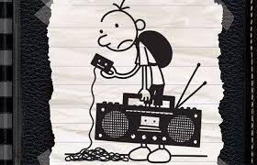
RULES I WOULD CHANGE
Change the total technology ban idea (supported by Greg’s mom and town members) into balanced use.
Change rules that embarrass students publicly (like punishments at camp).

Slide 5

DIFFERENCES BETWEEN OLD SCHOOL AND NEW SCHOOL
OLD SCHOOL (in the book) | NEW SCHOOL (modern life)
No electronics | Phones and video games
Outdoor survival camps | Comfortable daily life
Strict discipline | More freedom
Manual work | Technology-based tasks
Limited communication | Social media

Slide 6

DO YOU PREFER OLD OR NEW RULES?
Technology should not control our lives, but it should not be completely removed either.

Slide 7


